Slide 1

Guidelines and Standards + some ISIS Mantid updates
Anders Markvardsen
STFC
Sep 2016, SINE2020, Coimbra

Slide 2
Outline
Progress since April 2016 meeting on task 10.2
Fitting: a way of comparing fit minimizers
A guideline for documenting data loaders
Interfacing software
Questionnaire
Some updates on works related more broadly to this WP

Slide 3
Testing fit minimizers
How do you know if one minimizer is better than another for fitting neutron data?

Slide 4
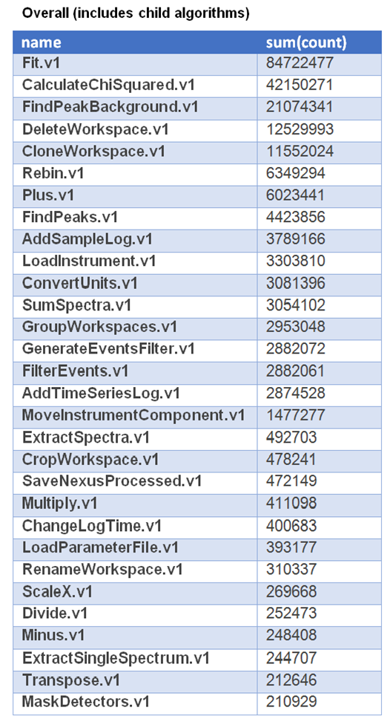
Most used algorithms in Mantid v3.7 since 6th June

Slide 5
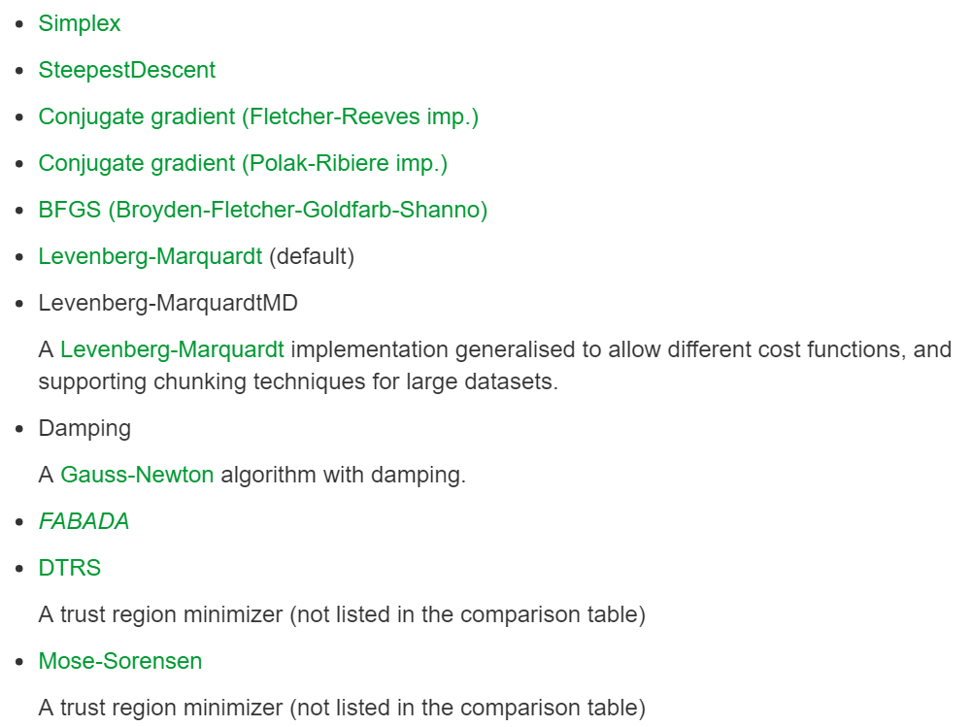
Example: fit minimizers in Mantid
as of August 2016
To appear in
v3.8 as
Trust-region
minimizer

Slide 6
Environment for testing fit minimizers
First version shipped with Mantid v3.7 June 2016
Collection of fit tests
Python scripts
Update to library schedule before NOBUGS conference

Slide 7
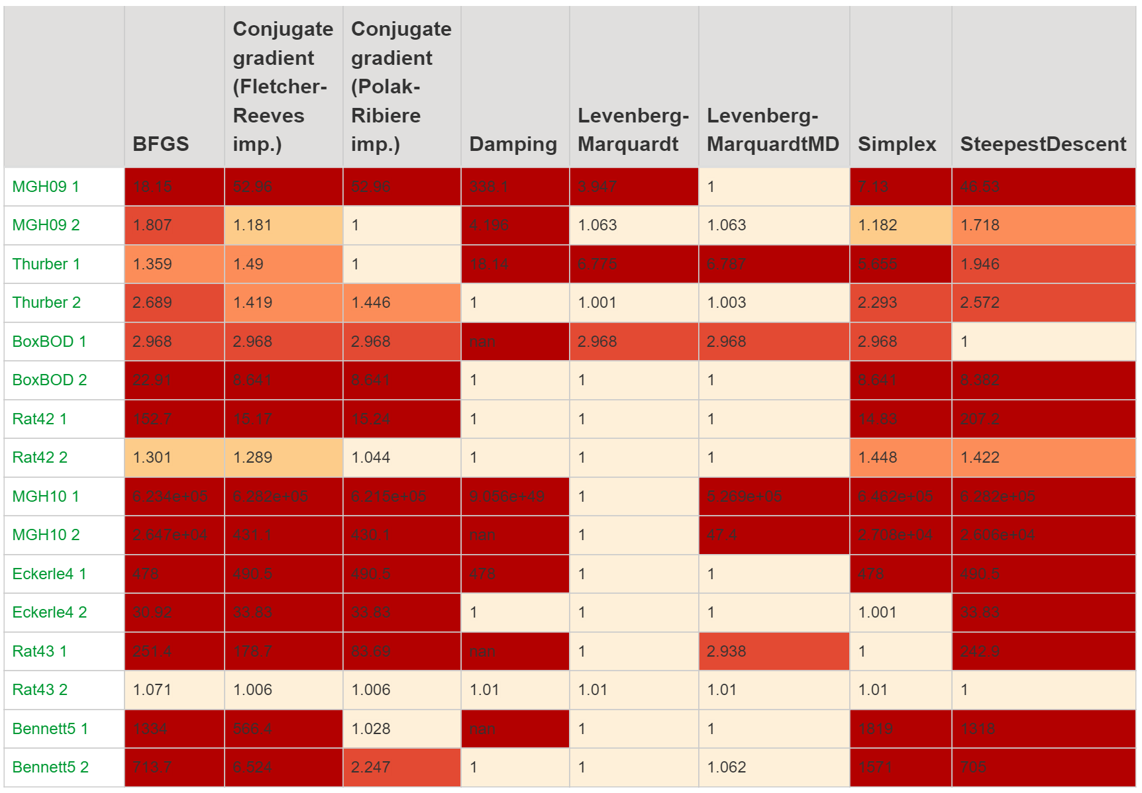
http://docs.mantidproject.org/nightly/concepts/FittingMinimizers.html

Slide 8
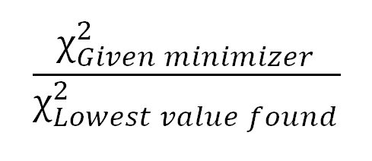
Metrics for comparing minimizers
Metric for accuracy/stability:
Metric for performance: Time

Slide 9
Fit minimizers – what next
Updates to library scripts before NOBUGS
Update table against new trust-region minimizer before NOBUGS
Table with real noisy neutron data examples (in progress)
Table with complex ties examples
Table with constraints examples
Table with examples using non-least-squares cost functions

Slide 10
To contribute with a Fit test
Data (x, y and optional errors)
Function to fit and initial function parameter values
Optional: Reference best values for the function parameters

Slide 11
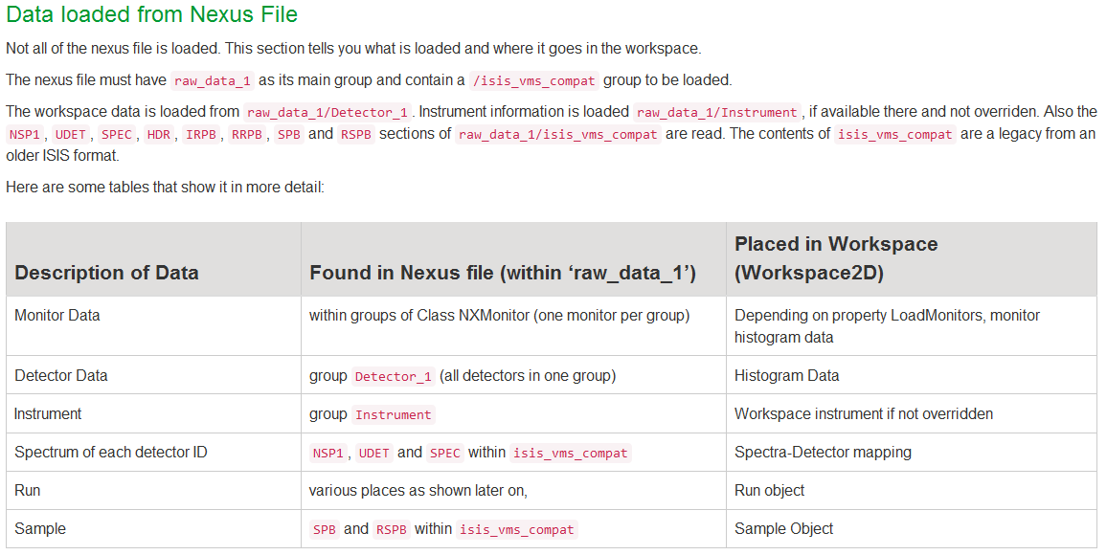
Completed: Additional guideline for documenting data loaders

Slide 12
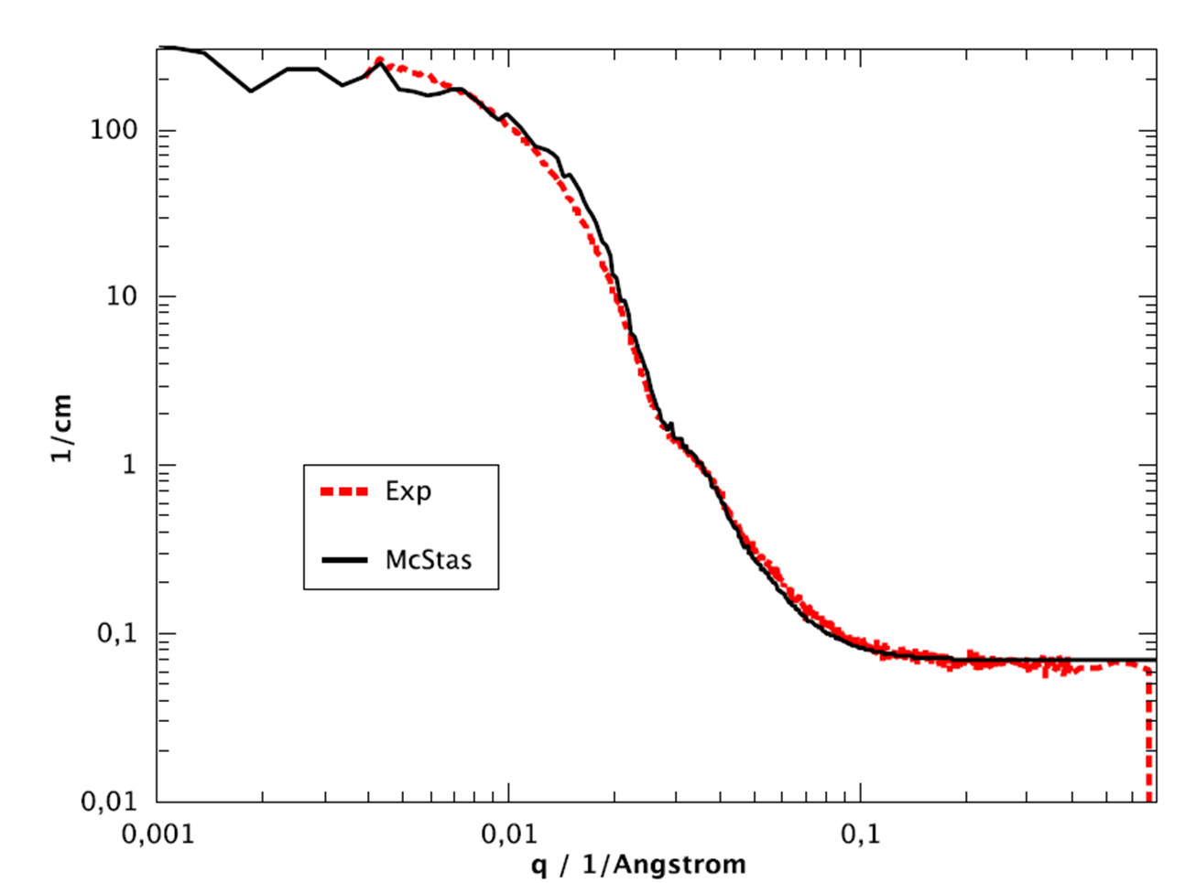
Software interoperability example
NOBUGS in October talk entitled “Integrating software: SASview, McStas and Mantid...”

Slide 13
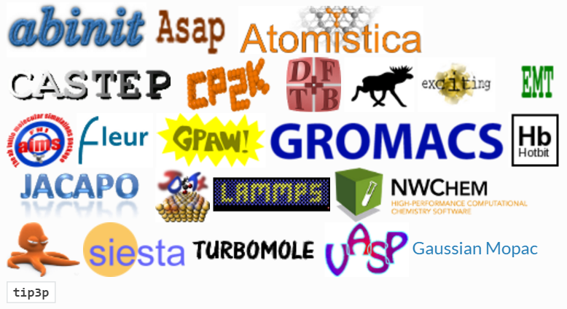
Interoperability: using ASE?
Atomic Simulation Environment
http://www.mantidproject.org/ASE

Slide 14
What would make neutron scientists use ASE?
ISIS (Sanghamitra in discussion with INS group)
Would like: Same output format returned regardless of the underlying simulation software
See no need for: ASE converting outputs from simulation software to S(Q,omega) convoluted with specific instrument resolution functions

Slide 15
Software questionnaire
One for each software (preferably not individuals personal opinions)
So far: Sasview, BornAgain, Mantid and McStas (thanks)
Circulate guidelines and standards document by end of the year

Slide 16
Guidelines: Software development tools
Programming languages: C++ and Python…
GUI library: Qt…
Data format: NeXus/hdf5…
Test environment: Jenkins…
Code repositories: Git. SVN? Cloud based vs not cloud based
Ticket/issue system: Trac/Github…
Targeted platforms: Linux/Mac/Windows? Tablets/mobile phones?
This will be updated using info from questionnaire also

Slide 17
Examples of Mantid contributions more broadly: tasks 10.2-4
Visualisation
NOBUGS talk by Steven Hahn (SNS) “Advanced Visualization Capabilities for Neutron Scattering Data”
Fitting (Mantid ‘wish’ list)
Better Python interface to fitting
Different default fit minimizers for different use cases
Global optimization?

Slide 18
Imaging at ISIS & Diamond
Simply interface to call software suite of imaging software and run jobs on remote STFC SCD cluster where requested (poster at NOBUGS on this)
First IMAT users Sep 2016
Support for NeXus/HDF5 data formats (ISIS/Diamond)
Larmor – imaging with polarised neutrons

Slide 19
MD visualisation and associated fitting
MD visualisation essential for instance: excitation, diffraction and imaging
MD excitation fitting requirements
Usability & customisability

Slide 20
ISIS - QENS
Technical report 2014: https://epubs.stfc.ac.uk/work/12239830
Technical report 2015: https://epubs.stfc.ac.uk/work/22354868
Bayesian fitting: http://docs.mantidproject.org/nightly/concepts/FABADA.html

Slide 21
ISIS - Reflectometry
Mantid – for data reduction
Work with STFC SCD on Rascal v2 for data analysis ongoing

Slide 22
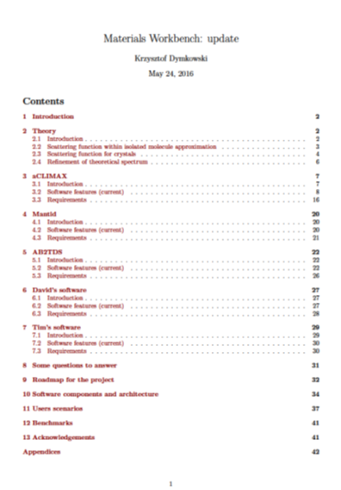
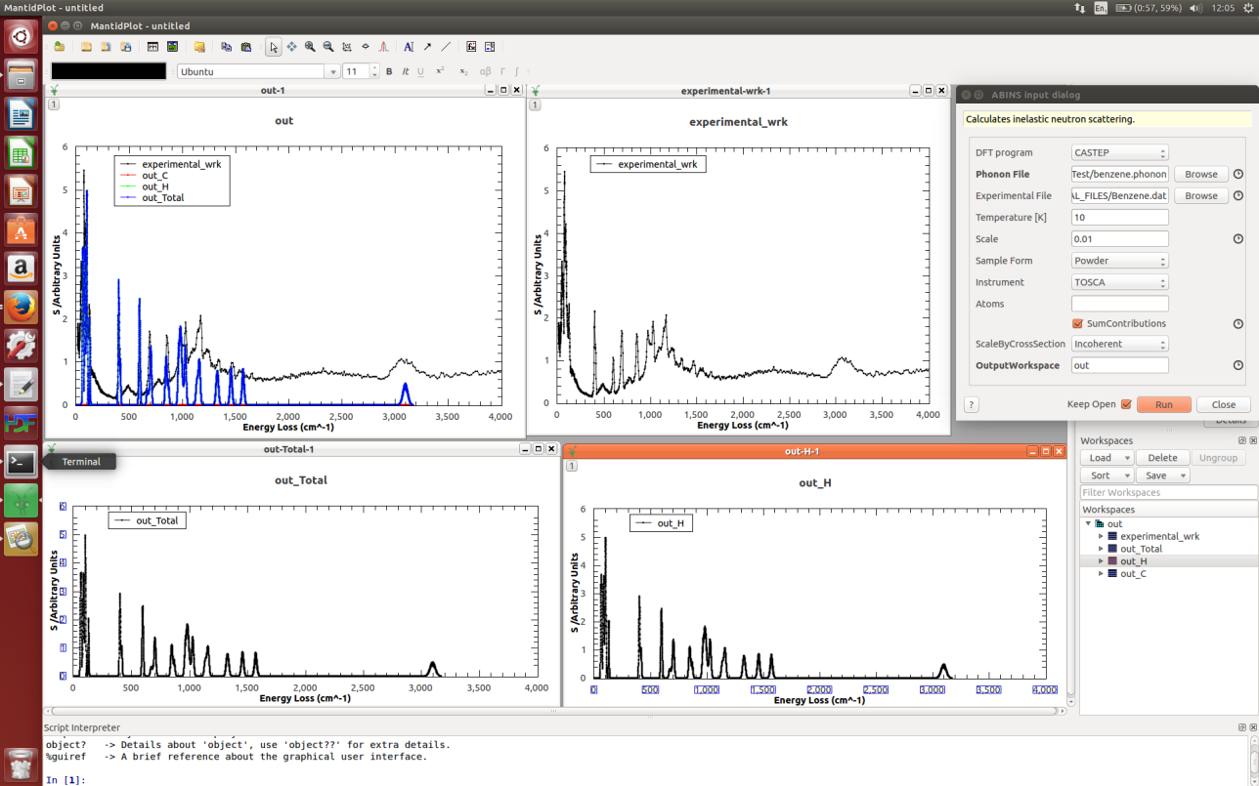
ISIS: Comparing Lattice Dynamics simulation outputs with measured data
In collaboration with STFC SCD.

Slide 23
Other technique areas at ISIS
SANS
Muon
Diffraction

Slide 24
Acknowledgements: task 10.2 work
Fitting
Mantid team, Federico Montesino Pouzols and Roman Tolchenov
SCD Numerical Group: Tyrone Rees, Nick Gould, Jonathan Hogg and Jennifer Scott
Documentation for data loaders
Mantid team and Karl Palmen

Slide 25
Mantid roadmap
Roadmap: https://docs.google.com/spreadsheets/d/1vjZ-vQpwa4FehvVHEPo8IXFbI8T1JMzfAWQ0xOsUrqM/pubhtml
Mantid 4.0: https://github.com/mantidproject/documents/blob/4f15d60923975ae9648d4ce230d85b78a809757c/Project-Management/PMB/Release%20Planning%20for%20Mantid%20version%204.pptx

